Slide 1

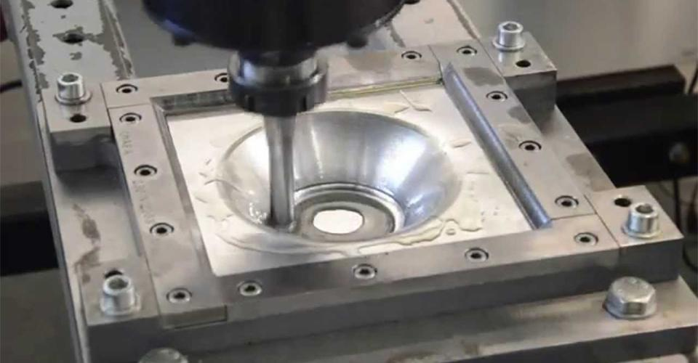



INCREMENTAL FORMING OF PERFORATED SS SHEETS
By,
Veeranala Varshitha Preetham
(22ME01028)
Under the guidance of,
Dr. Gaurav Bartarya
Associate Professor,
School of Mechanical Sciences,
Indian Institute of Technology Bhubaneswar

Slide 2

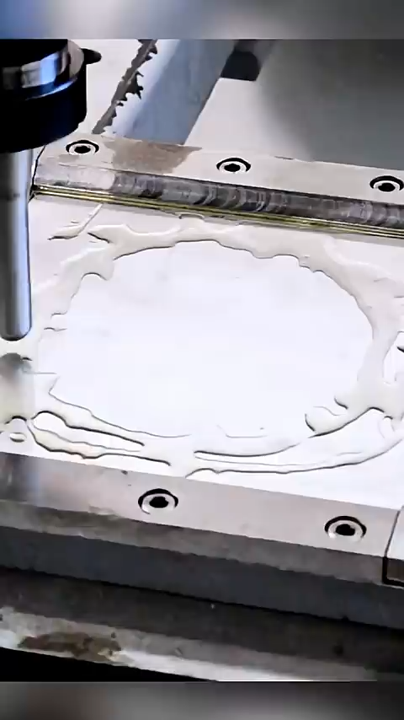
CONTENTS
Introduction
Literature review
Literature gap
Methodology
Model development
Results and discussion
Validation and Conclusion
Future scope

Slide 3

INTRODUCTION
ISF is a die-less, flexible sheet metal forming process used to create complex 3D shapes
Eliminates the need for expensive dies unlike deep drawing, stamping, hydroforming
Relies on localized plastic deformation using a small rounded tool
Toolpath is generated from a CAD model, enabling customization and rapid prototyping

Slide 4
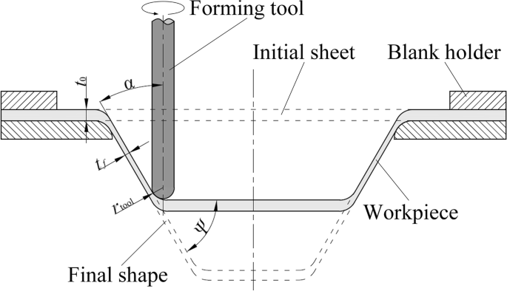
WORKING PRINCIPLE
Sheet is formed by localized plastic deformation
Deformation zone moves with the tool, forming the shape layer by layer.
Material undergoes tangential & radial tensile stresses, compression on top, tension at bottom, and shear due to friction.
Lubrication reduces friction and enhances surface finish.

Slide 5
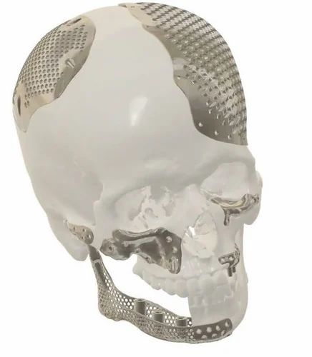
APPLICATIONS
Cranial Implant Fabrication
Restore skull defects caused by trauma, tumour removal, or congenital abnormalities.
Shape derived from Medical Imaging for Implant Design
Perforations promote bone tissue ingrowth and osseointegration, improving implant stability.

Slide 6
LITERATURE REVIEW
Author(s) | Contributions
Anees Jaleel & C. Sathiya Narayanan (2023) – Formability of perforated SS304L | Studied ISF behaviour of perforated sheets; analysed deformation zones, thickness reduction, and improved understanding of perforation influence on formability.
A. Chennakesava Reddy (2017) – Formability of SS304 | Experimental + numerical study on forming elliptical cups; evaluated formability limits and validated simulation accuracy for SS304 in ISF.
Ajay Kumar et al. (2020) – Forming Forces in SPIF | For AA6061, investigated effect of major process parameters on forming forces; established parameter–force relationships useful for tool design and process optimization.
Gabriel Centeno et al. (2017) – Formability & Failure of SS304 | Provided experimental + numerical validation of AISI SS304 formability; studied failure mechanisms and validated fracture predictions for SPIF.

Slide 7
LITERATURE GAP
Research on SPIF of perforated SS304L is limited despite its distinct deformation behavior
Existing SS304L studies vary tool parameters simultaneously, without isolating the sheet’s response to each parameter individually
Numerical studies rarely evaluate all major SPIF responses simultaneously for perforated SS304L
Optimization studies for perforated SS304L are very limited

Slide 8
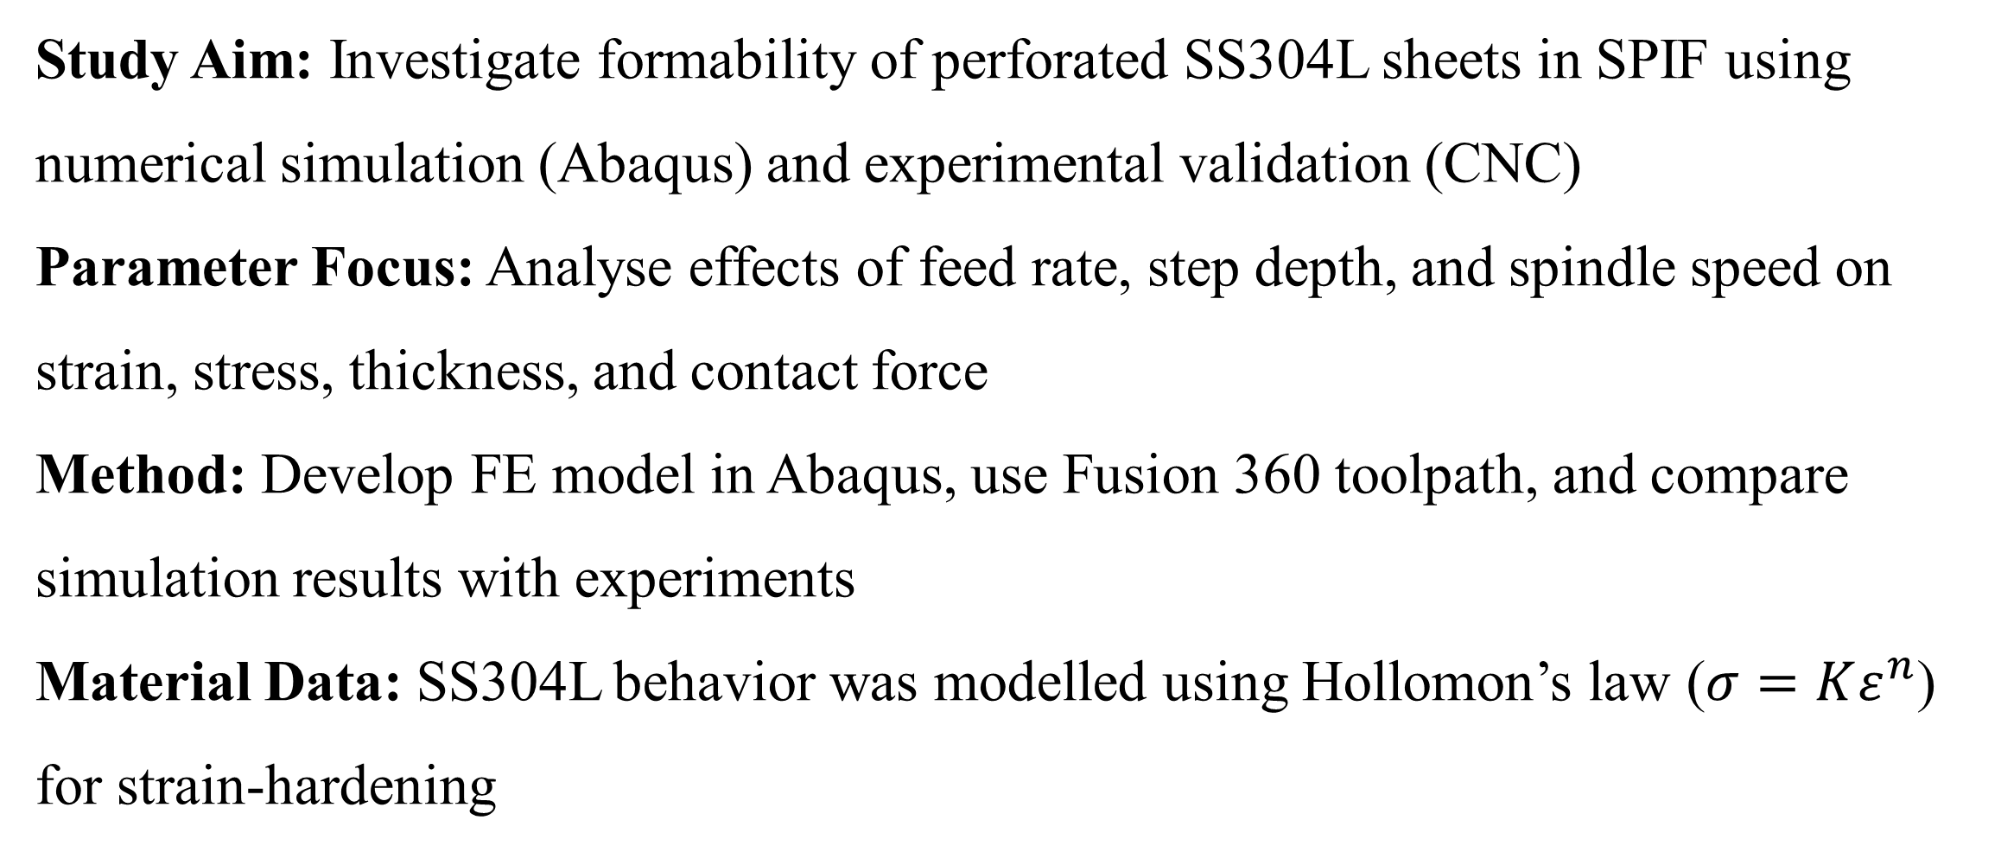
OBJECTIVE AND METHODOLOGY
Study Aim: Investigate formability of perforated SS304L sheets in SPIF using numerical simulation (Abaqus) and experimental validation (CNC)
Parameter Focus: Analyse effects of feed rate, step depth, and spindle speed on strain, stress, thickness, and contact force
Method: Develop FE model in Abaqus, use Fusion 360 toolpath, and compare simulation results with experiments
Material Data: SS304L behavior was modelled using Hollomon’s law ($σ=Kε^{n}$) for strain-hardening

Slide 9
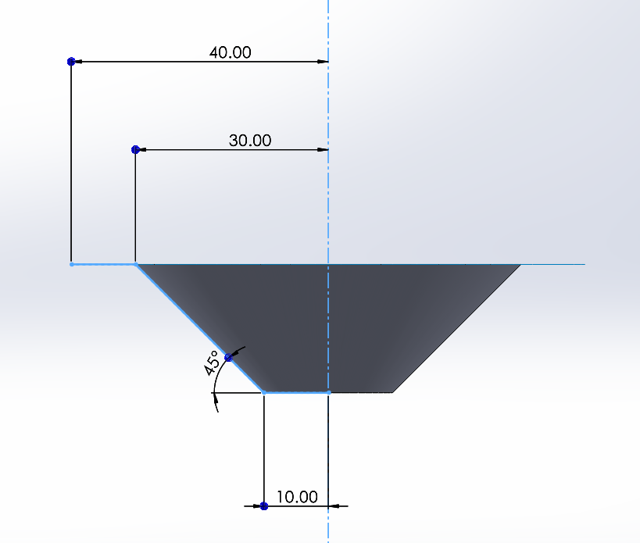
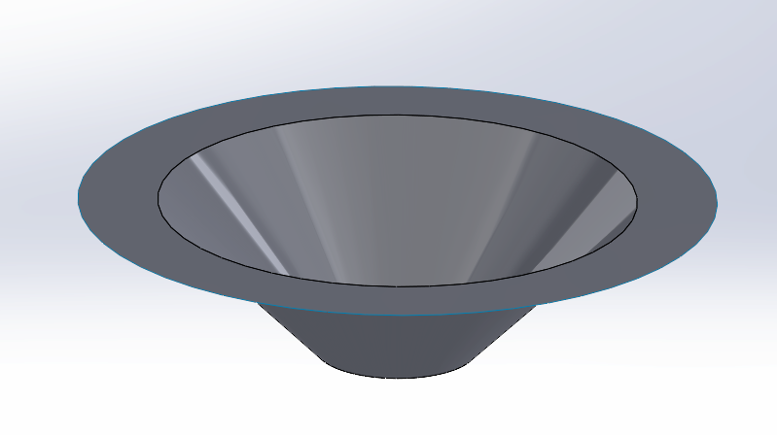
MODEL DEVELOPMENT
Geometry designed in Solid Works

Slide 10
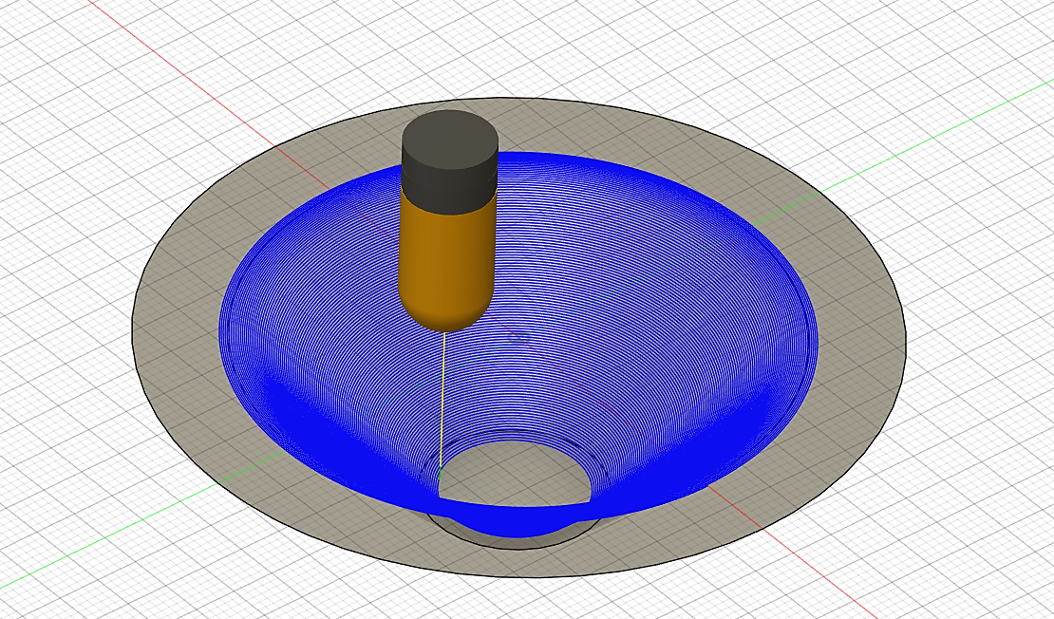
MODEL DEVELOPMENT
Tool path generated from Autodesk Fusion 360
Spiral tool path
Forming tool type: Ball end tool (hemispherical tip)
Tool diameter: 10 mm

Slide 11
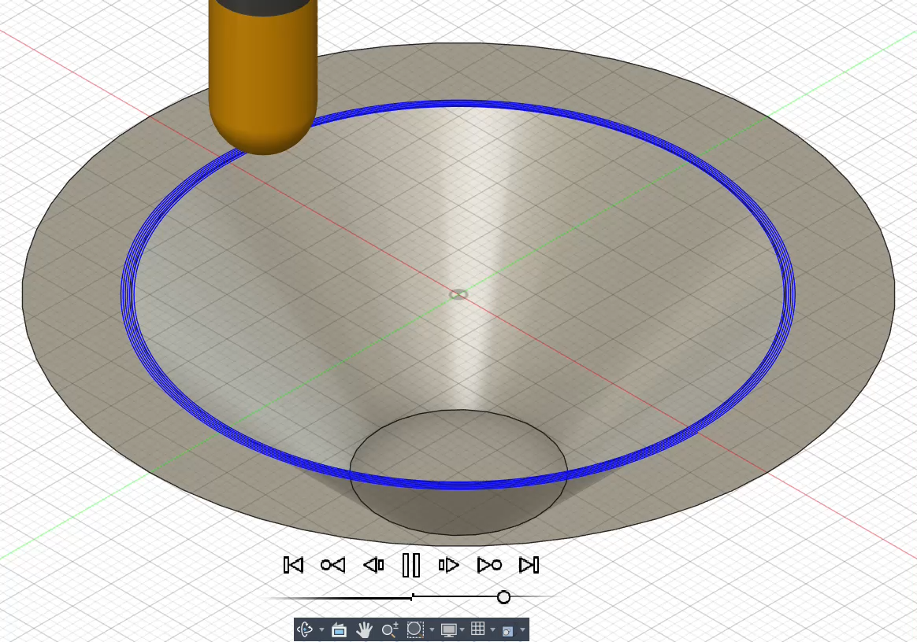
TOOL PATH GENERATION

Slide 12


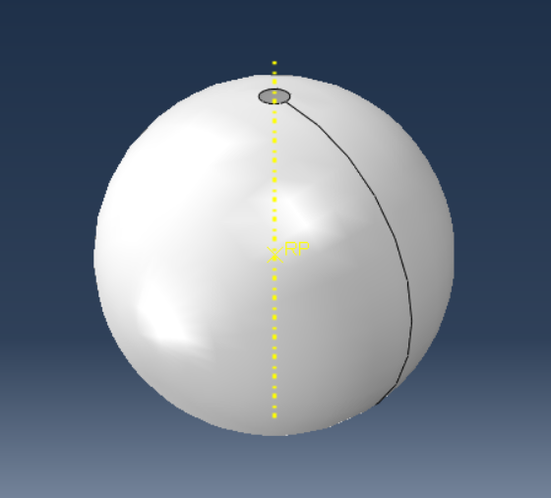
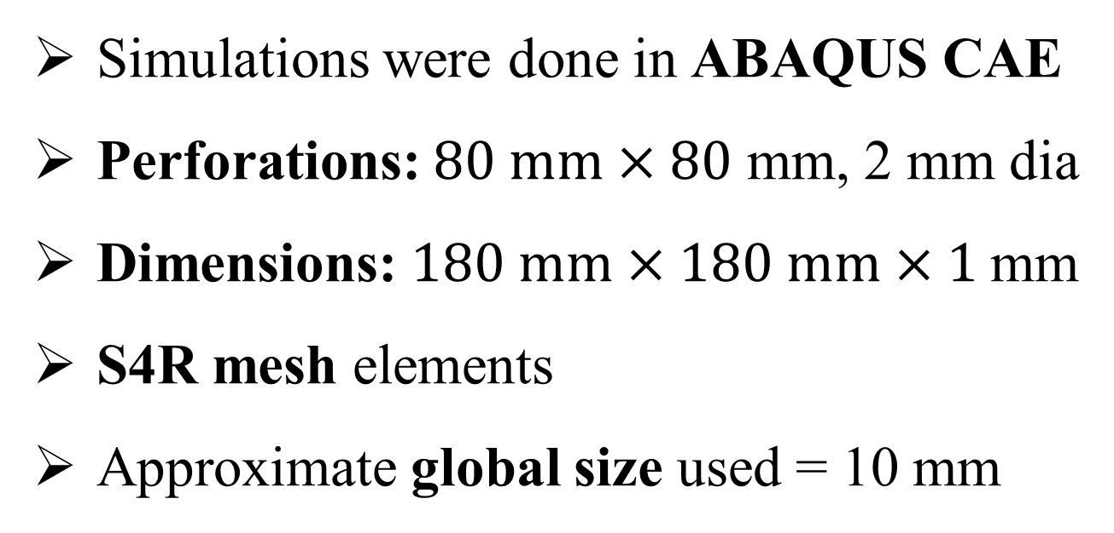
MODEL DEVELOPMENT
Simulations were done in ABAQUS CAE
Perforations: $80 mm×80$ mm, 2 mm dia
Dimensions: $180 mm×180 mm×1$mm
S4R mesh elements
Approximate global size used = 10 mm

Slide 13
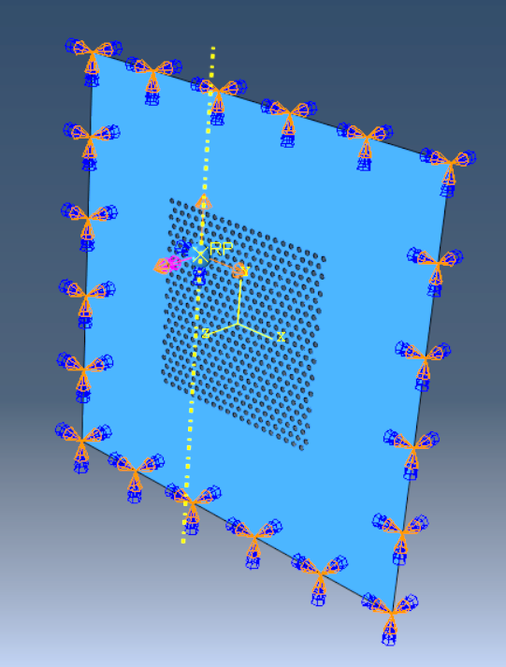
MODEL DEVELOPMENT
Boundary Conditions :
ENCASTRE for sheet edges
Tool path coordinates with respect to time (X,Y,Z)
Tool speed (rpm)
Reference values : 800 mm/min, 300 rpm, 0.2 mm

Slide 14
RESULTS AND DISCUSSION
Contact Force Magnitude (upon changing feed rates)

Slide 15
RESULTS AND DISCUSSION
Contact Force Magnitude (upon changing step depth)

Slide 16
RESULTS AND DISCUSSION
Contact Force Magnitude (upon changing tool speed in rpm)

Slide 17
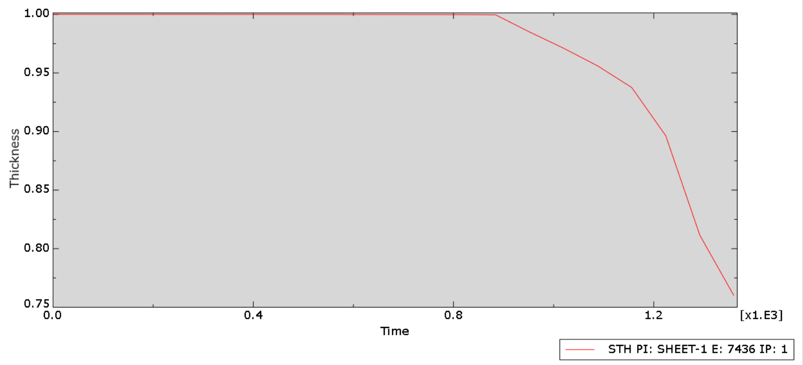
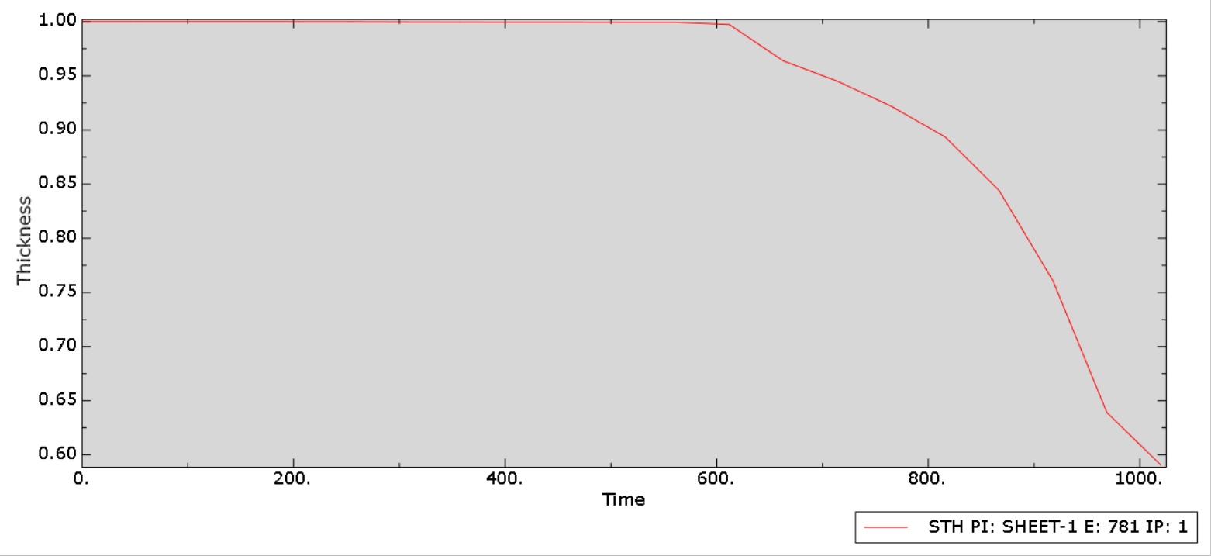
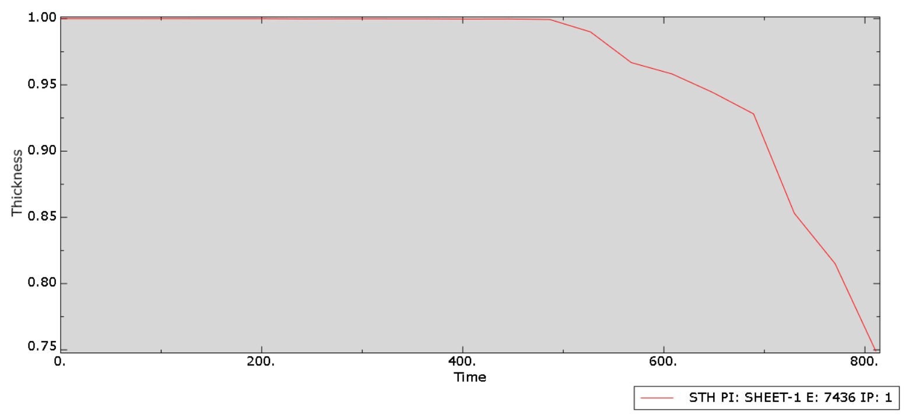
RESULTS AND DISCUSSION
Sheet thickness (upon changing feed rate)
Feed rate (mm/min) | Sheet thickness (mm) | Time of completion | Thickness change duration | Thickness drop characteristic
600 | 0.75 | 1359.853 | 600 – 1359 | Gradual
800 | 0.6 | 1019.889 | 600 – 1019 | Sharp
1000 | 0.75 | 810.885 | 500 – 810 | Very sharp

Slide 18
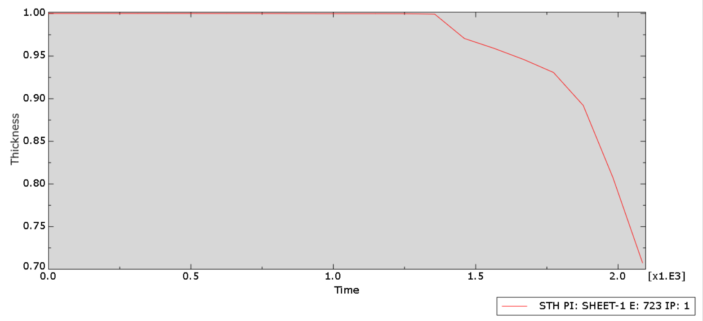

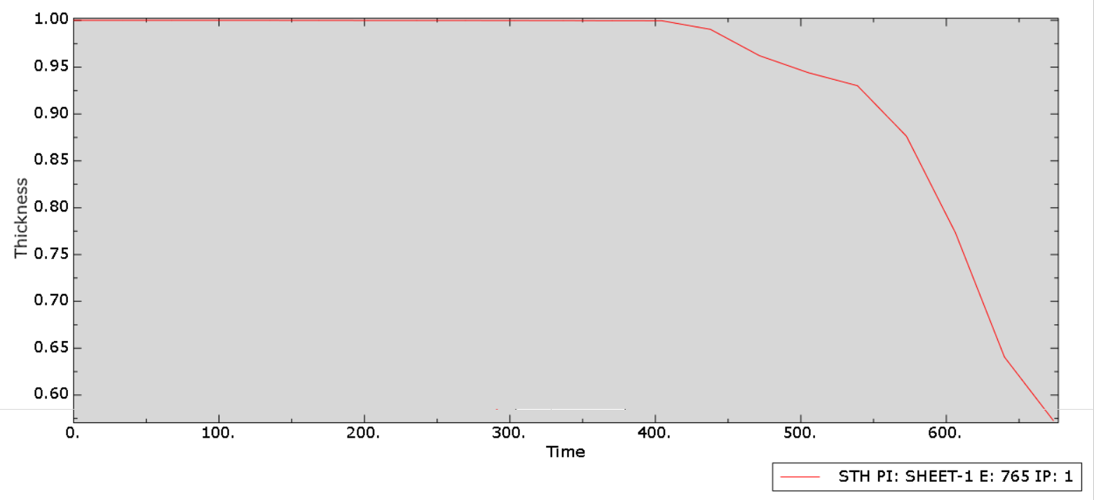
RESULTS AND DISCUSSION
Sheet thickness (upon changing step depth)
Step depth (mm) | Sheet thickness (mm) | Time of completion | Thickness change duration | Thickness drop characteristic
0.1 | 0.7 | 2046.047 | 1200 - 2046 | Gradual
0.2 | 0.6 | 1019.889 | 600 – 1019 | Sharp
0.3 | 0.625 | 673.662 | 400 – 673 | Very sharp

Slide 19
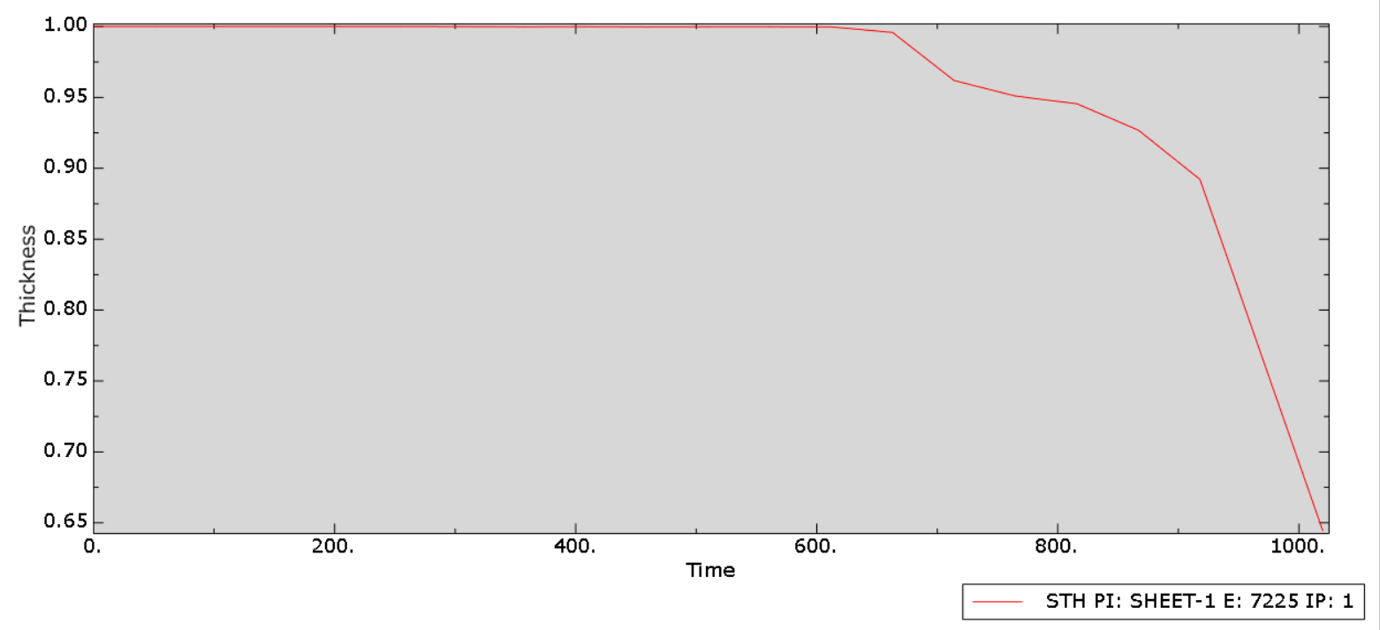

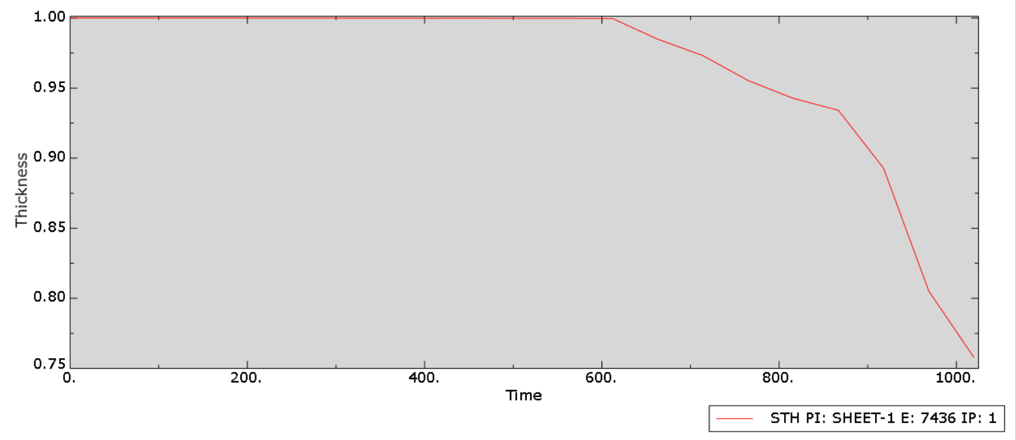
RESULTS AND DISCUSSION
Sheet thickness (upon changing tool speed in rpm)
Tool speed (rpm) | Sheet thickness (mm) | Formability
200 | 0.65 | less
300 | 0.6 | high
400 | 0.75 | lesser

Slide 20
RESULTS AND DISCUSSION
Von Mises stresses (upon changing feed rate)

Slide 21
RESULTS AND DISCUSSION
Von Mises stresses (upon changing step depth)

Slide 22
RESULTS AND DISCUSSION
Von Mises stresses (upon changing tool speed in rpm)

Slide 23
RESULTS AND DISCUSSION
Strain diagram (upon changing feed rate)

Slide 24
RESULTS AND DISCUSSION
Strain diagram (upon changing step depth)

Slide 25
RESULTS AND DISCUSSION
Strain diagram (upon changing tool speed in rpm)

Slide 26
VALIDATION AND CONCLUSION
The simulation results closely matched trends reported in literature for perforated SS304L sheets, confirming the accuracy of the model.
Research papers show that moderate spindle speed improves formability.
Results also found 300 rpm gives lowest stress and best strain behaviour.
Literature states that medium step depth gives stable deformation.
Results also showed 0.2 mm step depth produced lowest stress and best thickness control.
Validation
Higher feed rates reduce stress and improve deformation smoothness in literature.
Results showed lower stresses at 800–1000 mm/min compared to 600 mm/min.
The validated results confirm that 300 rpm, 800 mm/min feed, and 0.2 mm step depth provide the most balanced forming performance.

Slide 27


FUTURE SCOPE
Study different perforation patterns and hole sizes. Explore warm/laser-assisted ISF to reduce thinning. Compare alternative biocompatible materials (Ti, Al). Apply toolpath optimisation for better accuracy. Include failure/damage modelling for crack prediction.

Slide 28
THANK YOU

